Slide 1

Emotion detection through face-expression system
High Impact Skills Development Program for Gilgit Baltistan
Shoaib Ud-din
Project instructor:
Mr. Muhammad Hassan

Slide 2
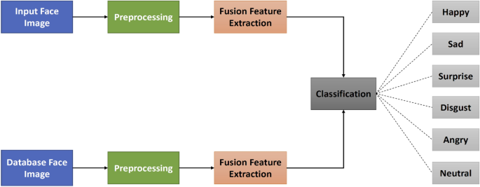
Block Diagram:
Fig1: flow chart

Slide 3
Methodology:
CNN(convolutional neural network) is used for image classification, based on face-expression
First layer contains 32 filters, 64 filters and third layer contains 128 filters. To extract more features of the image.
I chose batch size of 64 for fast training.
I chose learning rate of 0.0001 for better accuracy.
Plot confusion matrix for analysis.

Slide 4
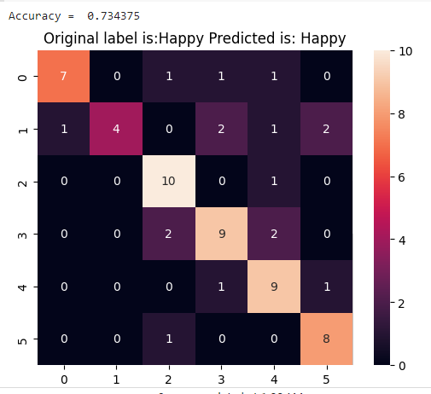
Confusion Matrix analysis:

Slide 5
Social Aspect of project:
There are several uses of emotion detection in real life applications.
Through emotion detection we can detect customers reviews on certain product.

Slide 6


